Slide 1
Random walks & Markov chain monte carlo
CS5330: Randomized Algorithms
Lecture 9
17/03/2020

Slide 2
Admin stuff
Week 8+9 problem set out (on Markov chains)
Midterm grades will be out this week
Please schedule meetings for final projects if not already done

Slide 3
Markov Chain algorithm design strategy
Engineer a Markov chain so that by taking along it, we are led closer to our objective.
What properties should the Markov chain satisfy so that we are led to a correct output in a small number of steps?

Slide 4
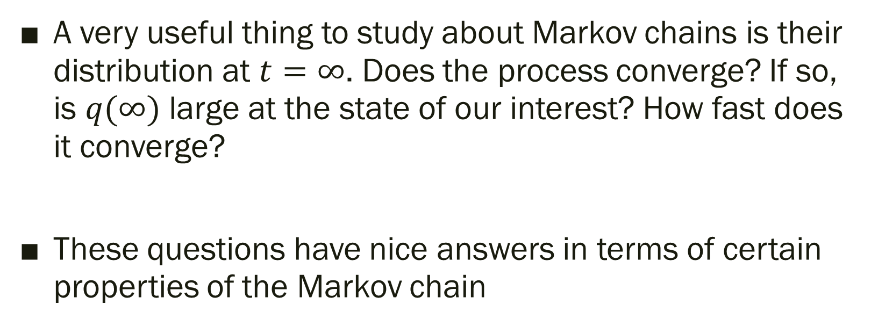

Towards $q\left(∞\right)$
A very useful thing to study about Markov chains is their distribution at $t=∞$. Does the process converge? If so, is $q(∞)$ large at the state of our interest? How fast does it converge?
These questions have nice answers in terms of certain properties of the Markov chain

Slide 5
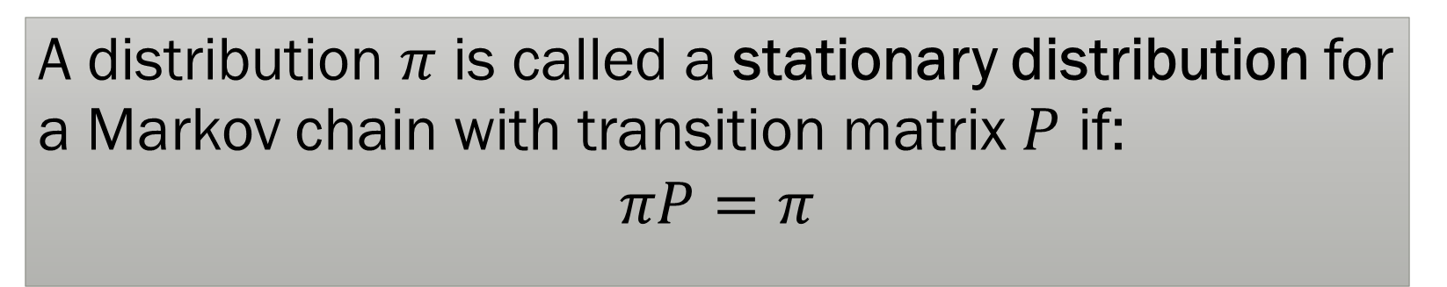
Stationary Distribution
A distribution $π$ is called a stationary distribution for a Markov chain with transition matrix $P$ if:
$$πP=π$$
Questions: Is there always a stationary distribution? Can there be many stationary distributions? Does the Markov chain always reach a stationary distribution? Is there convergence? What do they look like?

Slide 6

Existence of $π$
Theorem: Every finite state Markov chain has a stationary distribution.
There can be many though…For example, union of two Markov chains on disjoint state spaces.

Slide 7
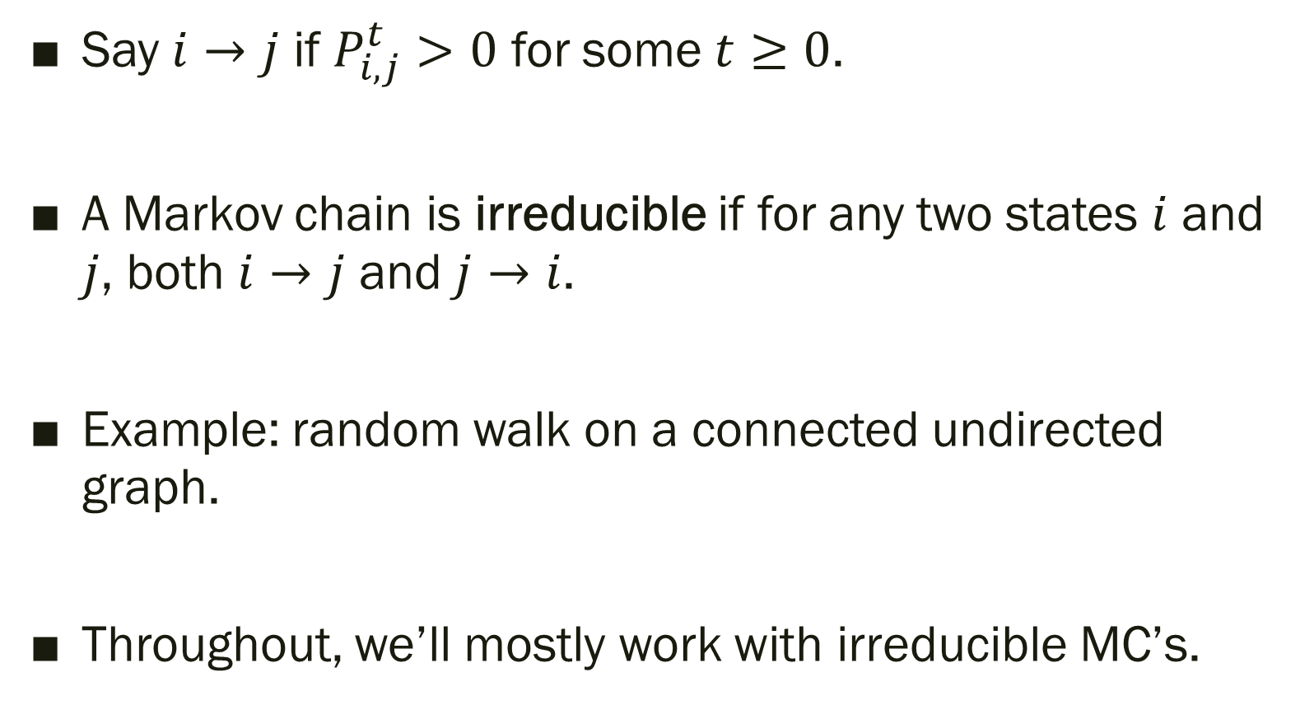
Irreducibility
Say $i→j$ if $P_{i,j}^{t}>0$ for some $t≥0$.
A Markov chain is irreducible if for any two states $i$ and $j$, both $i→j$ and $j→i$.
Example: random walk on a connected undirected graph.
Throughout, we’ll mostly work with irreducible MC’s.

Slide 8

Uniqueness of $π$
Theorem: Every finite state irreducible Markov chain has exactly one stationary distribution.
Okay, what is it?

Slide 9
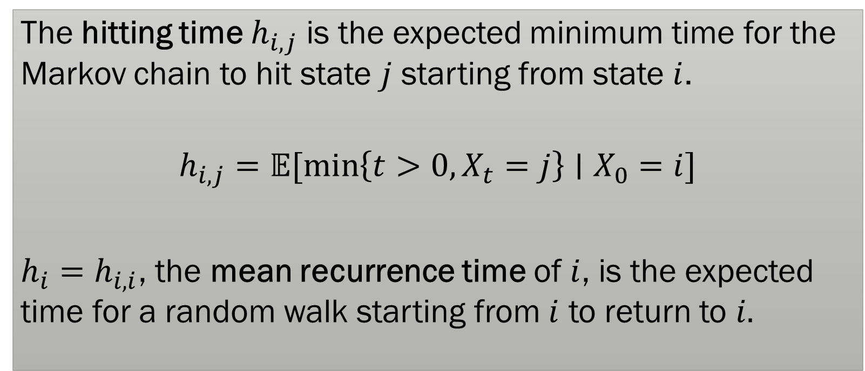
Hitting Time
The hitting time $h_{i,j}$ is the expected minimum time for the Markov chain to hit state $j$ starting from state $i$.
$$h_{i,j}=𝔼[\min\left\{t>0, X_{t}=j\right\}∣X_{0}=i]$$
$h_{i}=h_{i,i}$, the mean recurrence time of $i$, is the expected time for a random walk starting from $i$ to return to $i.$

Slide 10
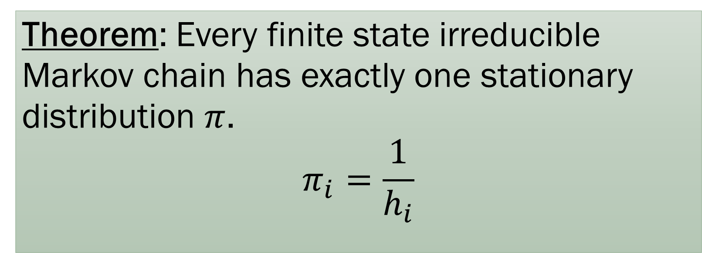

Uniqueness of $π$
We usually use this in the reverse direction: to compute $h_{i}$ given $π_{i}$
Theorem: Every finite state irreducible Markov chain has exactly one stationary distribution $π$.
$$π_{i}=\frac{1}{h_{i}}$$

Slide 11


Convergence?
$$1$$
1
2
$$1$$
States oscillate between 1 and 2. No convergence!

Slide 12
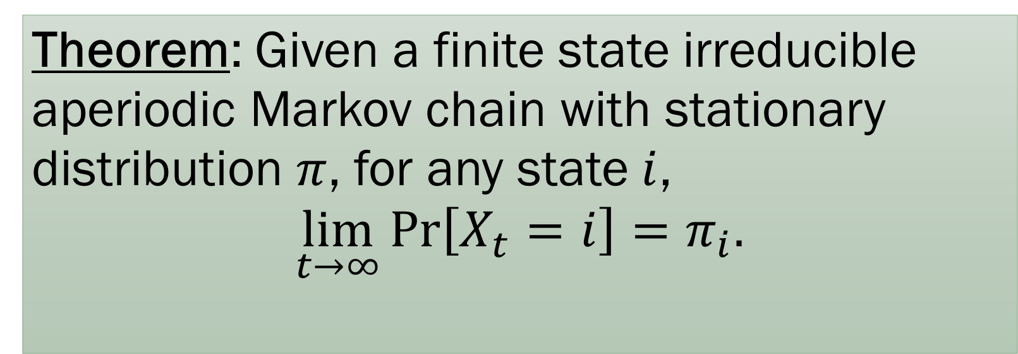

Convergence
A Markov chain is aperiodic if for all states $i$,
$$\gcd\left(\left\{t:P_{i,i}^{t}>0\right\}\right)=1$$
Theorem: Given a finite state irreducible aperiodic Markov chain with stationary distribution $π$, for any state $i$,
$$\lim_{t→∞}{\operatorname{Pr}\left[X_{t}=i\right]}=π_{i}.$$

Slide 13
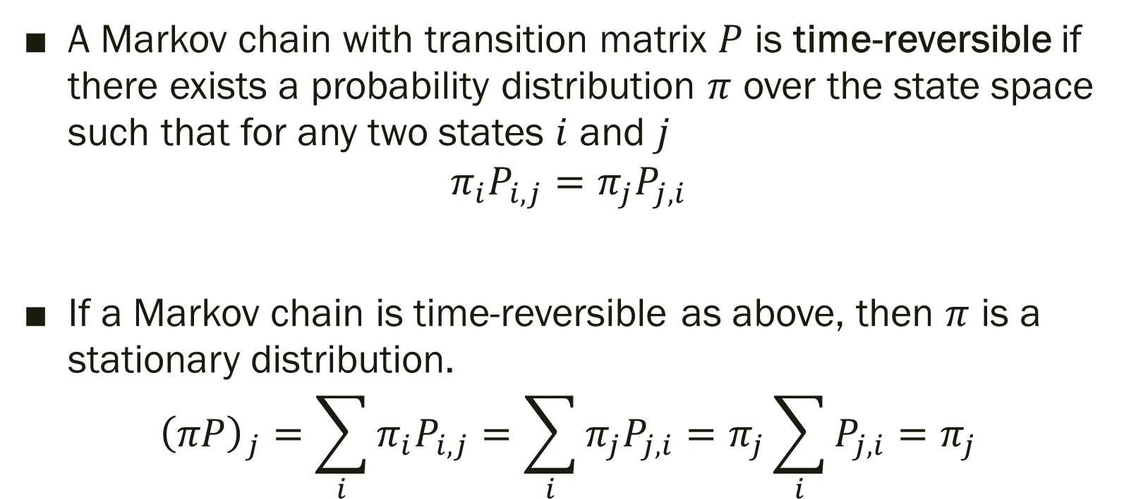
Time-Reversible Markov Chains
A Markov chain with transition matrix $P$ is time-reversible if there exists a probability distribution $π$ over the state space such that for any two states $i$ and $j$
$$π_{i}P_{i,j}=π_{j}P_{j,i}$$
If a Markov chain is time-reversible as above, then $π$ is a stationary distribution.
$${\left(πP\right)}_{j}=\sum_{i}{π_{i}P_{i,j}}=\sum_{i}{π_{j}P_{j,i}}=π_{j}\sum_{i}{P_{j,i}}=π_{j}$$

Slide 14
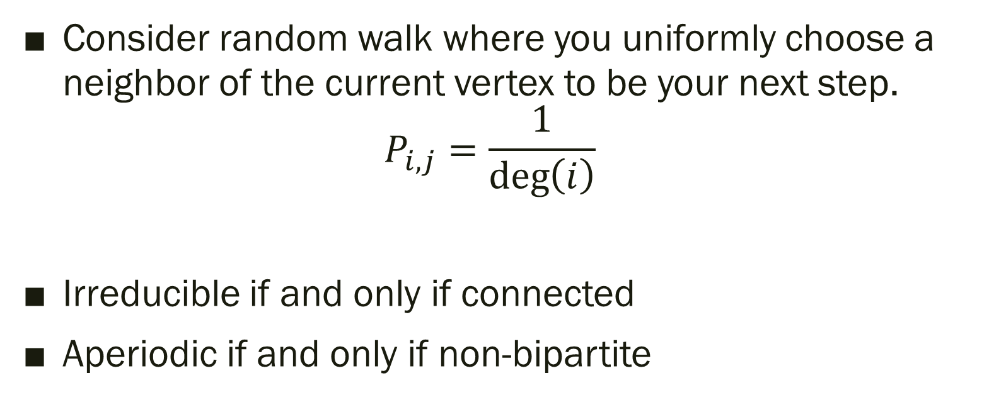
Random walk on undirected graph
Consider random walk where you uniformly choose a neighbor of the current vertex to be your next step.
$P_{i,j}=\frac{1}{\deg\left(i\right)}$
Irreducible if and only if connected
Aperiodic if and only if non-bipartite

Slide 15
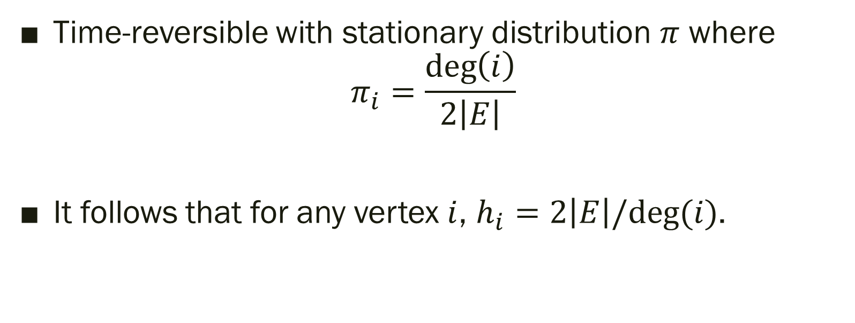
Stationary Distribution
Time-reversible with stationary distribution $π$ where
$π_{i}=\frac{\deg\left(i\right)}{2\left|E\right|}$
It follows that for any vertex $i$, $h_{i}=2\left|E\right|/deg⁡(i)$.

Slide 16
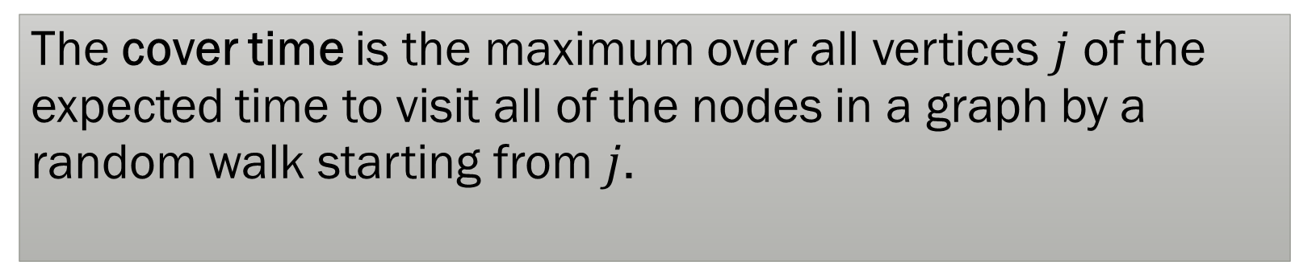

Commute Time and Cover Time
The commute time between two vertices $i$ and $j$ is:
$$C_{ij}=h_{ij}+h_{ji}$$
The cover time is the maximum over all vertices $j$ of the expected time to visit all of the nodes in a graph by a random walk starting from $j$.

Slide 17
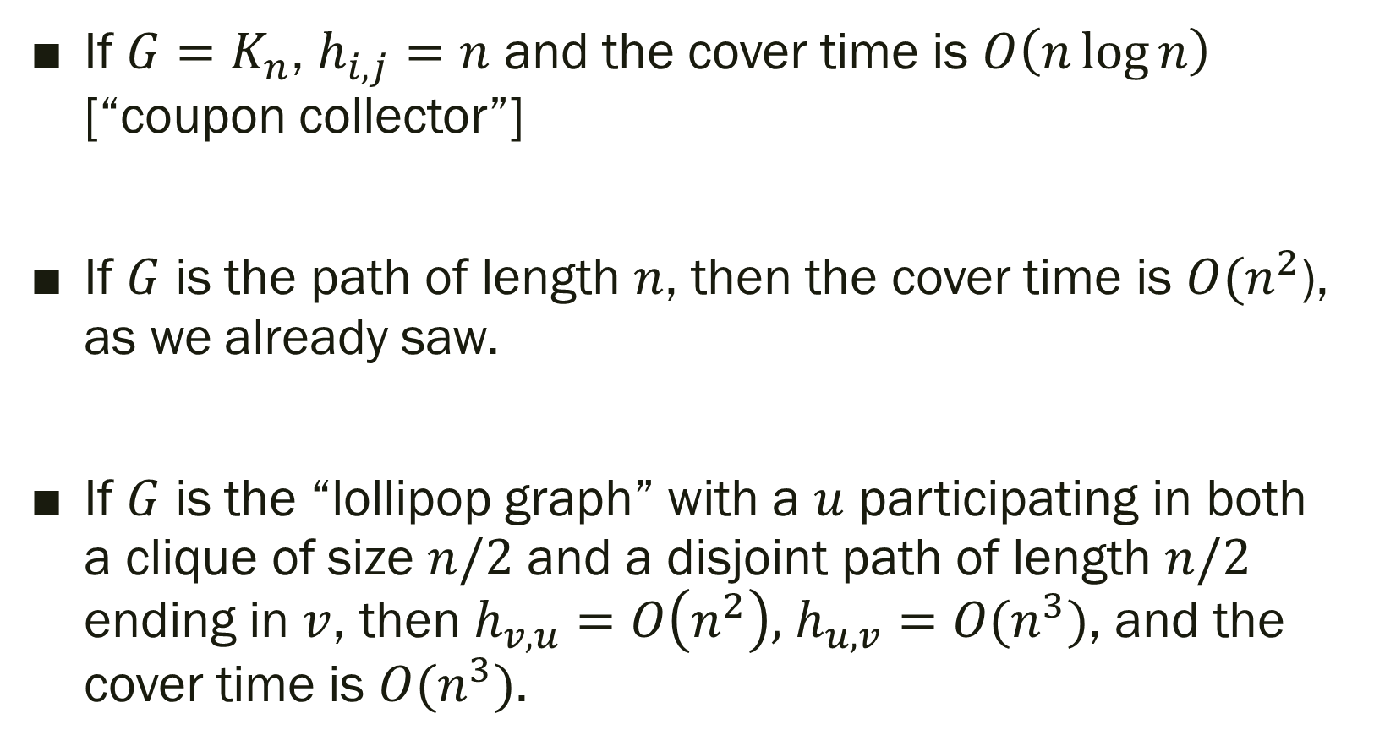
Examples
If $G=K_{n}$, $h_{i,j}=n$ and the cover time is $O\left(n\log{n}\right)$ [“coupon collector”]
If $G$ is the path of length $n$, then the cover time is $O(n^{2}$), as we already saw.
If $G$ is the “lollipop graph” with a $u$ participating in both a clique of size $n/2$ and a disjoint path of length $n/2$ ending in $v$, then $h_{v,u}=O\left(n^{2}\right),$ $h_{u,v}=O(n^{3})$, and the cover time is $O(n^{3})$.

Slide 18
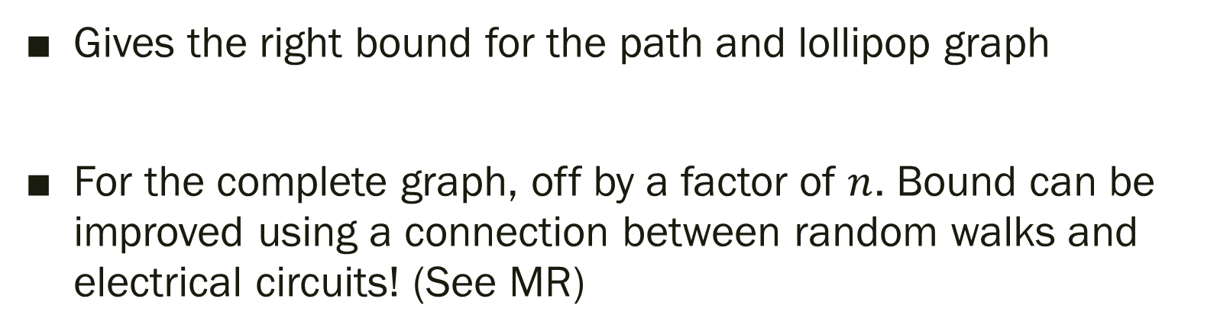
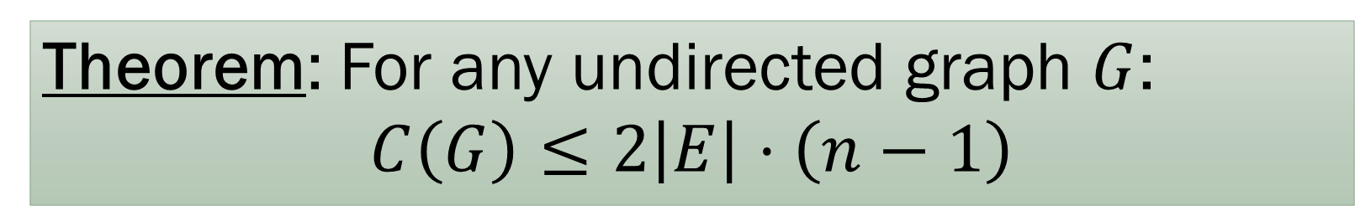
Bound on Cover Time
Theorem: For any undirected graph $G$:
$$C\left(G\right)≤2\left|E\right|⋅\left(n−1\right)$$
Gives the right bound for the path and lollipop graph
For the complete graph, off by a factor of $n$. Bound can be improved using a connection between random walks and electrical circuits! (See MR)

Slide 19
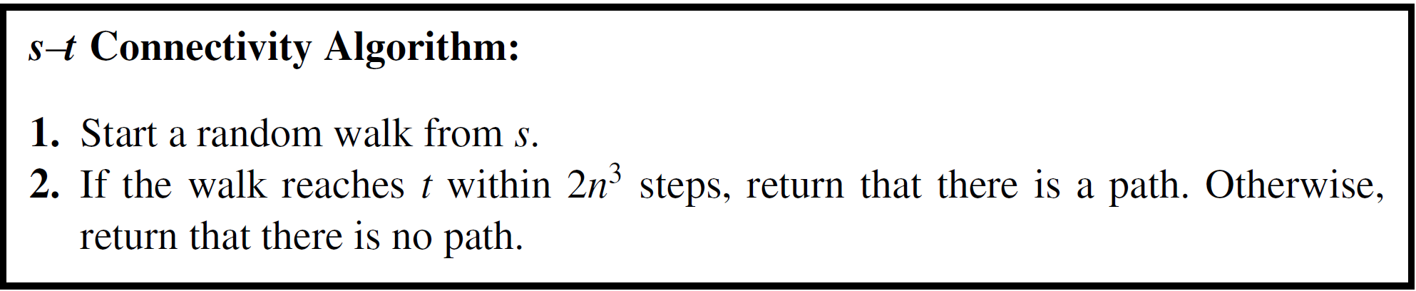

Connectivity
Uses only $O\left(\log{n}\right)$ bits of memory, in contrast to BFS or DFS!

Slide 20
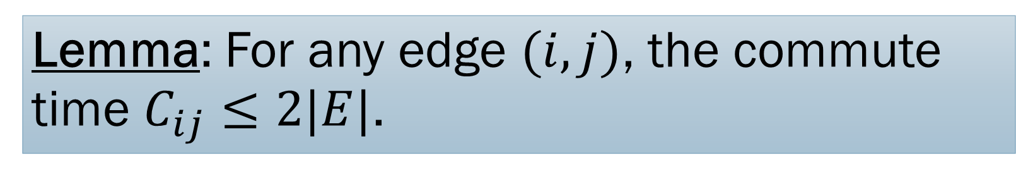
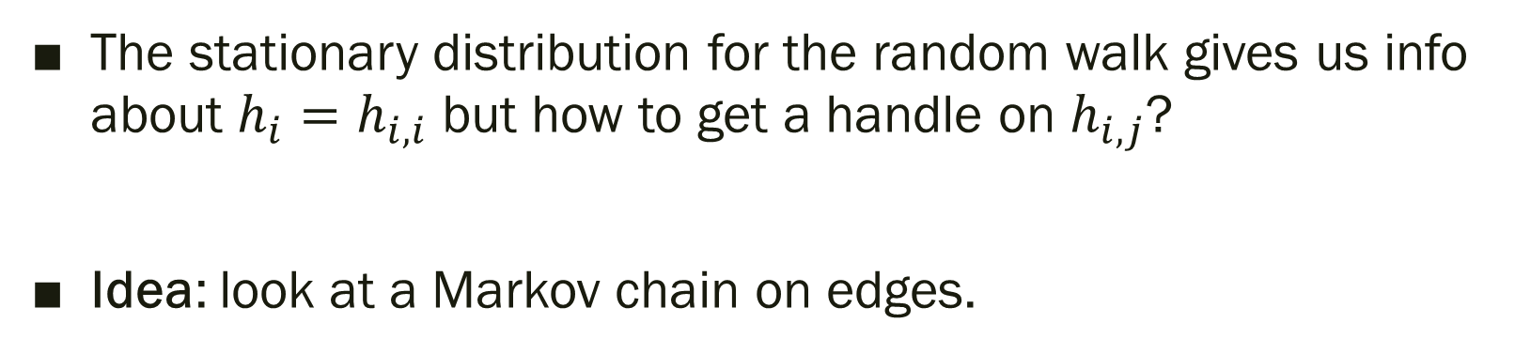
Commute time for edges
Lemma: For any edge $(i,j)$, the commute time $C_{ij}≤2|E|$.
The stationary distribution for the random walk gives us info about $h_{i}=h_{i,i}$ but how to get a handle on $h_{i,j}$?
Idea: look at a Markov chain on edges.

Slide 21
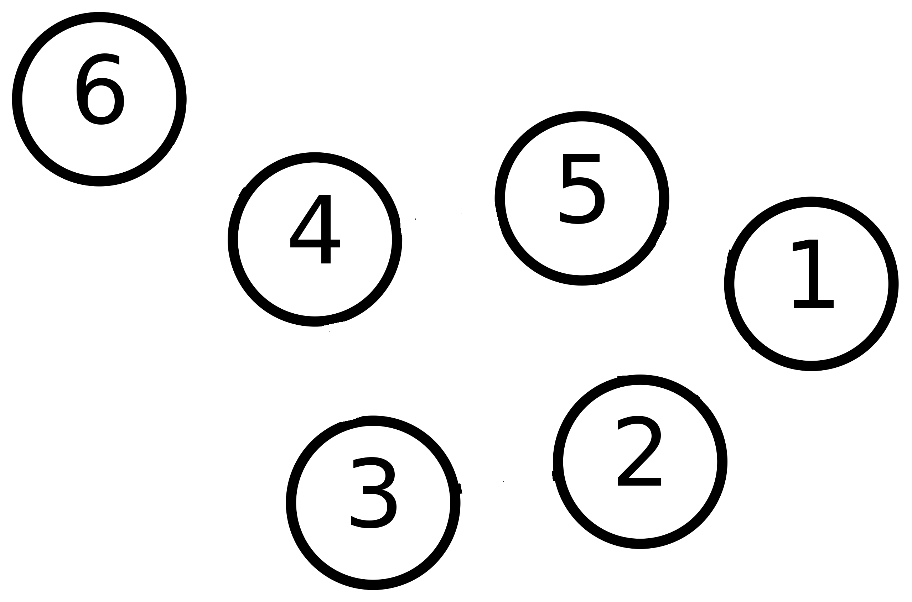
Markov Chain on Vertices

Slide 22
Markov Chain on Vertices

Slide 23
Markov Chain on Vertices

Slide 24
Markov Chain on Vertices

Slide 25
Markov Chain on Vertices

Slide 26
Markov Chain on Vertices

Slide 27
Markov Chain on Vertices

Slide 28
Markov Chain on Edges

Slide 29
Markov Chain on Edges

Slide 30
Markov Chain on Edges

Slide 31
Markov Chain on Edges

Slide 32
Markov Chain on Edges

Slide 33
Markov Chain on Edges

Slide 34
Markov Chain on Edges

Slide 35
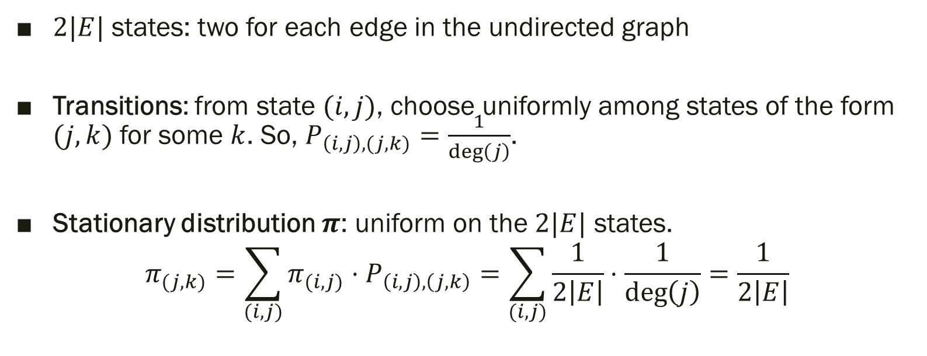
Markov Chain on Edges
$2|E|$ states: two for each edge in the undirected graph
Transitions: from state $(i,j)$, choose uniformly among states of the form $(j,k)$ for some $k$. So, $P_{\left(i,j\right),(j,k)}=\frac{1}{\deg\left(j\right)}$.
Stationary distribution $π$: uniform on the $2|E|$ states.
$$π_{(j,k)}=\sum_{(i,j)}{π_{(i,j)}⋅P_{\left(i,j\right),\left(j,k\right)}}=\sum_{(i,j)}{\frac{1}{2\left|E\right|}⋅\frac{1}{\deg\left(j\right)}}=\frac{1}{2\left|E\right|}$$

Slide 36
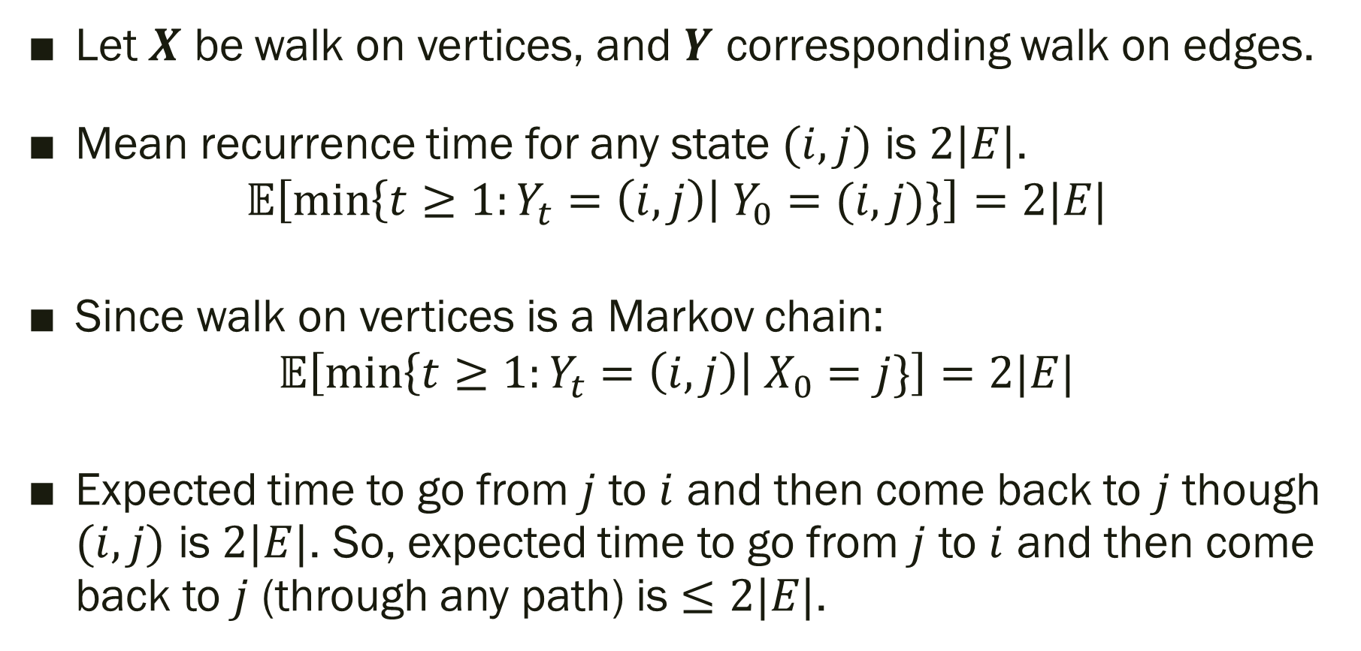
Markov Chain on Edges
Let $X$ be walk on vertices, and $Y$ corresponding walk on edges.
Mean recurrence time for any state $(i,j)$ is $2|E|$.
$$𝔼\left[\min\left\{t≥1:Y_{t}=\left(i,j\right)\right| Y_{0}=(i,j)\}\right]=2|E|$$
Since walk on vertices is a Markov chain:
$$𝔼\left[\min\left\{t≥1:Y_{t}=\left(i,j\right)\right| X_{0}=j\}\right]=2|E|$$
Expected time to go from $j$ to $i$ and then come back to $j$ though $(i,j)$ is $2|E|$. So, expected time to go from $j$ to $i$ and then come back to $j$ (through any path) is $≤2|E|$.

Slide 37

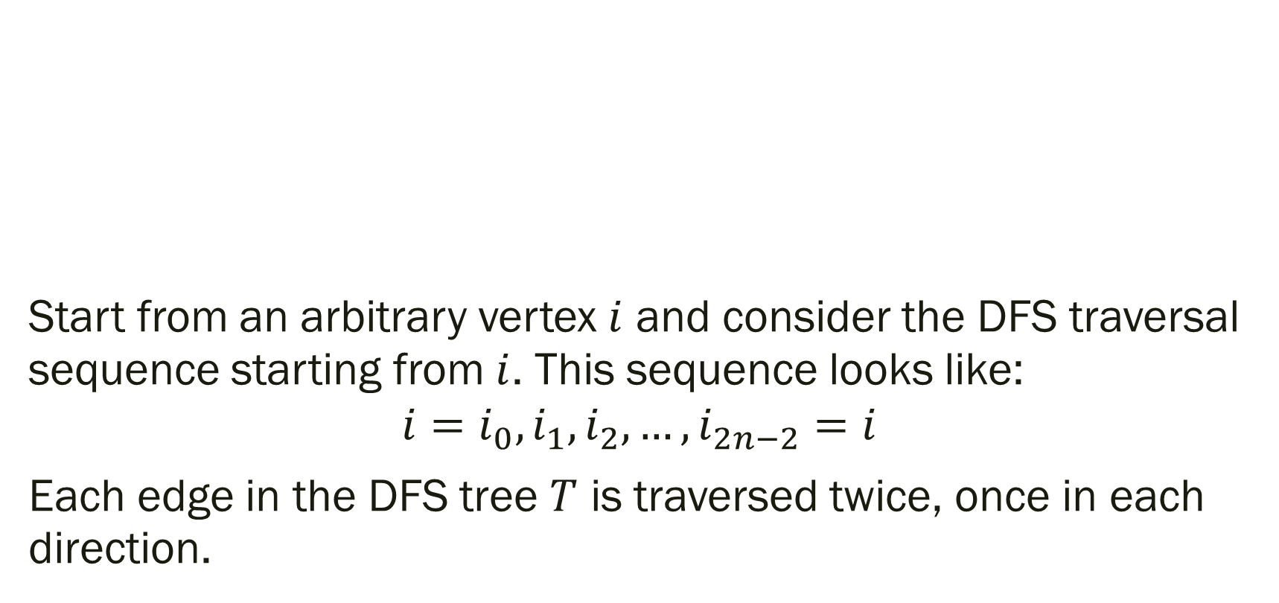
Bounding the Cover Time
Theorem: For any undirected graph $G$:
$$C\left(G\right)≤2\left|E\right|⋅\left(n−1\right)$$
Start from an arbitrary vertex $i$ and consider the DFS traversal sequence starting from $i$. This sequence looks like:
$$i=i_{0},i_{1},i_{2},…, i_{2n−2}=i$$
Each edge in the DFS tree $T$ is traversed twice, once in each direction.

Slide 38
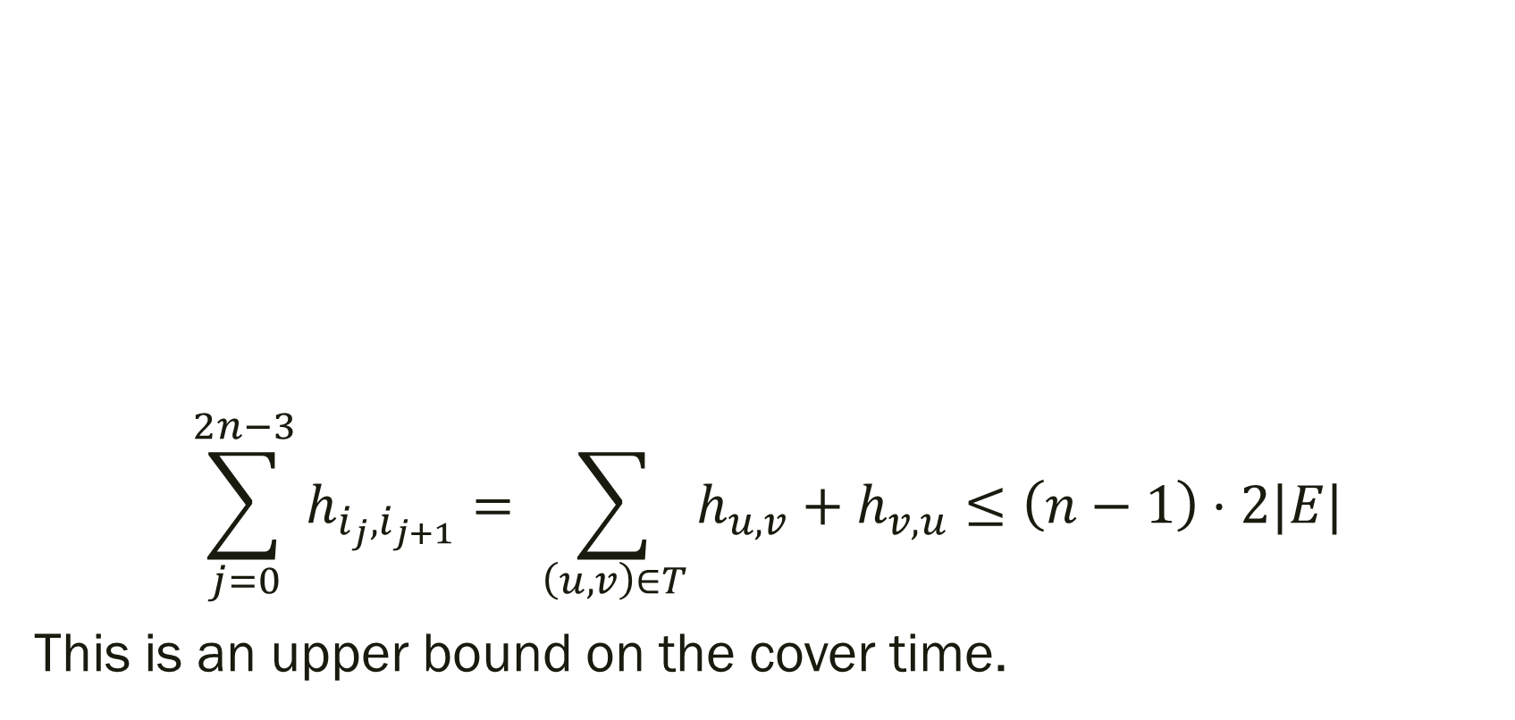
Bounding the Cover Time
Theorem: For any undirected graph $G$:
$$C\left(G\right)≤2\left|E\right|⋅\left(n−1\right)$$
$$\sum_{j=0}^{2n−3}{h_{i_{j},i_{j+1}}}= \sum_{\left(u,v\right)∈T}{h_{u,v}+h_{v,u}}≤\left(n−1\right)⋅2|E|$$
This is an upper bound on the cover time.

Slide 39

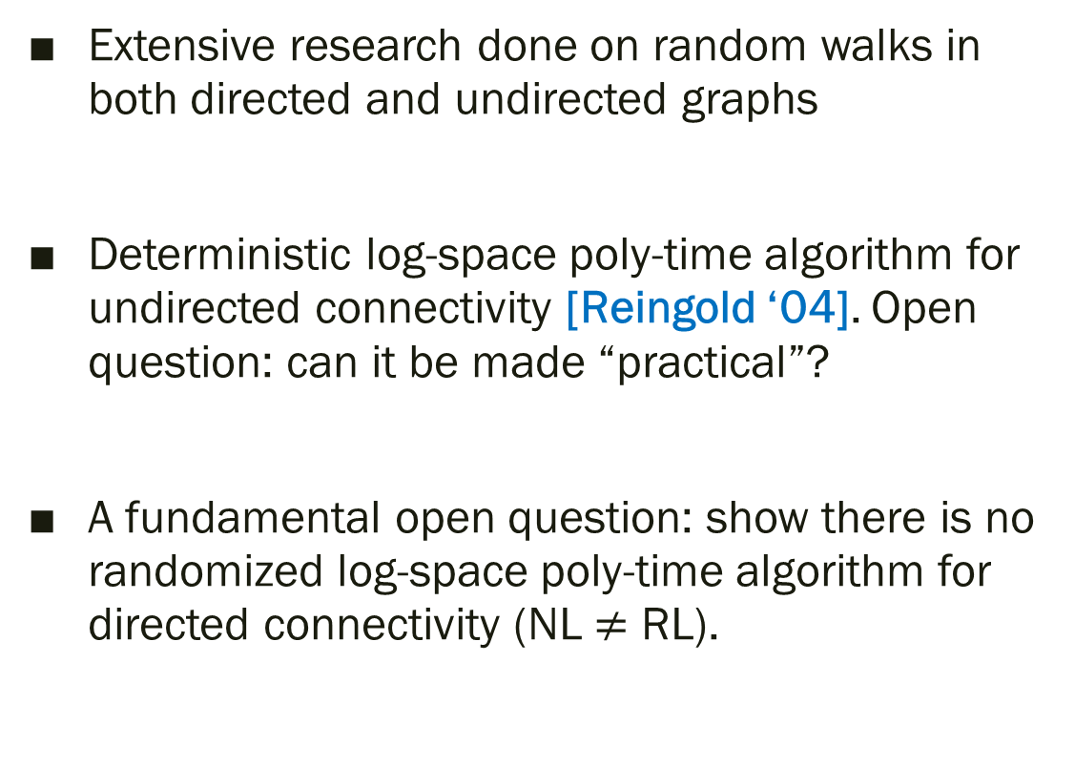
(Much) more on random walks…
Extensive research done on random walks in both directed and undirected graphs
Deterministic log-space poly-time algorithm for undirected connectivity [Reingold ‘04]. Open question: can it be made “practical”?
A fundamental open question: show there is no randomized log-space poly-time algorithm for directed connectivity (NL $≠$ RL).

Slide 40
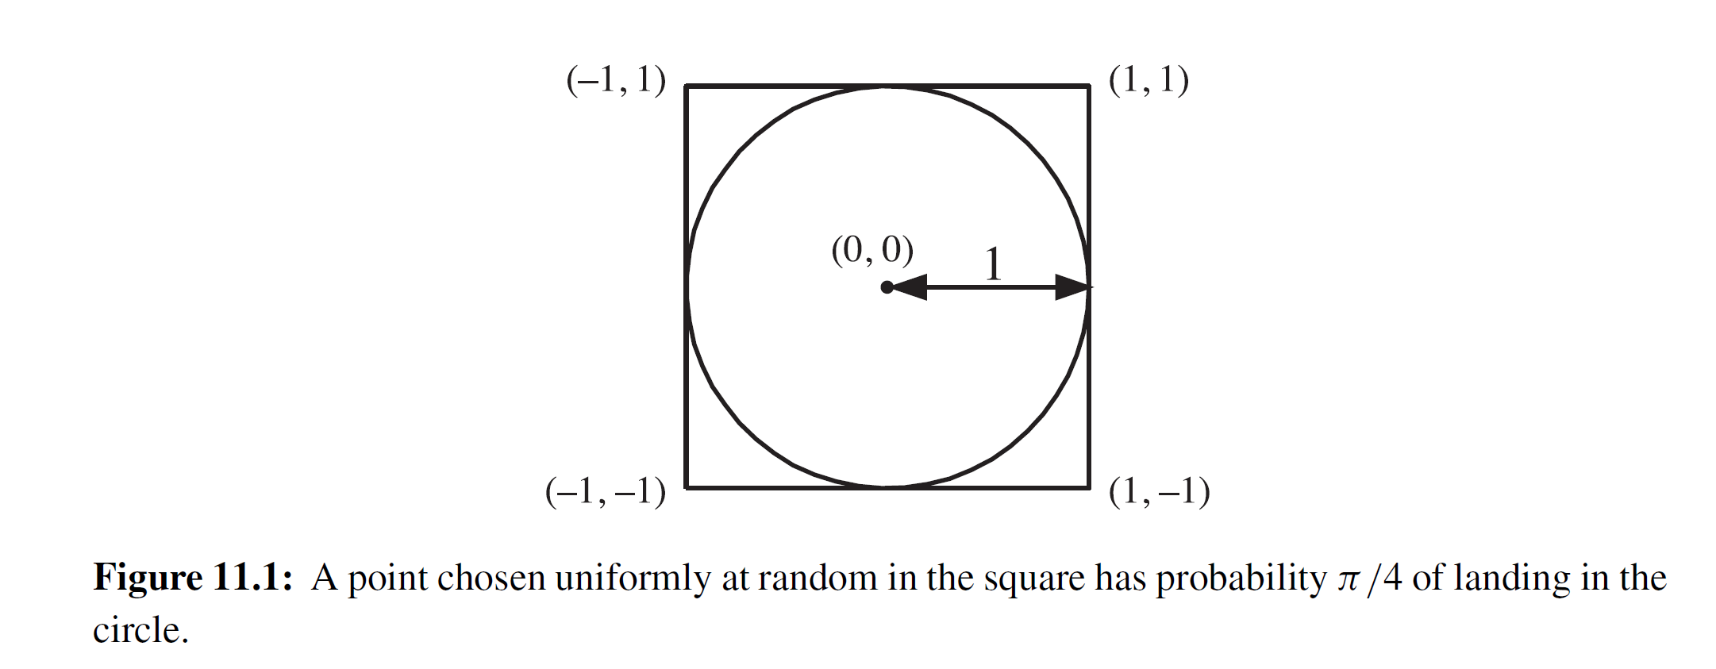
Sampling
Monte Carlo method: basic tool in all of science and engineering!

Slide 41
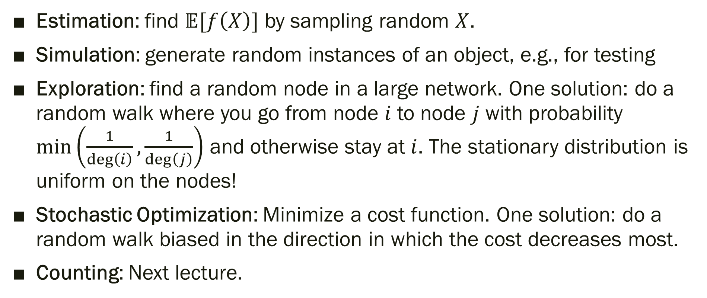
Why sample?
Estimation: find $𝔼[f\left(X\right)]$ by sampling random $X$.
Simulation: generate random instances of an object, e.g., for testing
Exploration: find a random node in a large network. One solution: do a random walk where you go from node $i$ to node $j$ with probability $\min\left(\frac{1}{\deg\left(i\right)},\frac{1}{\deg\left(j\right)}\right)$ and otherwise stay at $i$. The stationary distribution is uniform on the nodes!
Stochastic Optimization: Minimize a cost function. One solution: do a random walk biased in the direction in which the cost decreases most.
Counting: Next lecture.

Slide 42
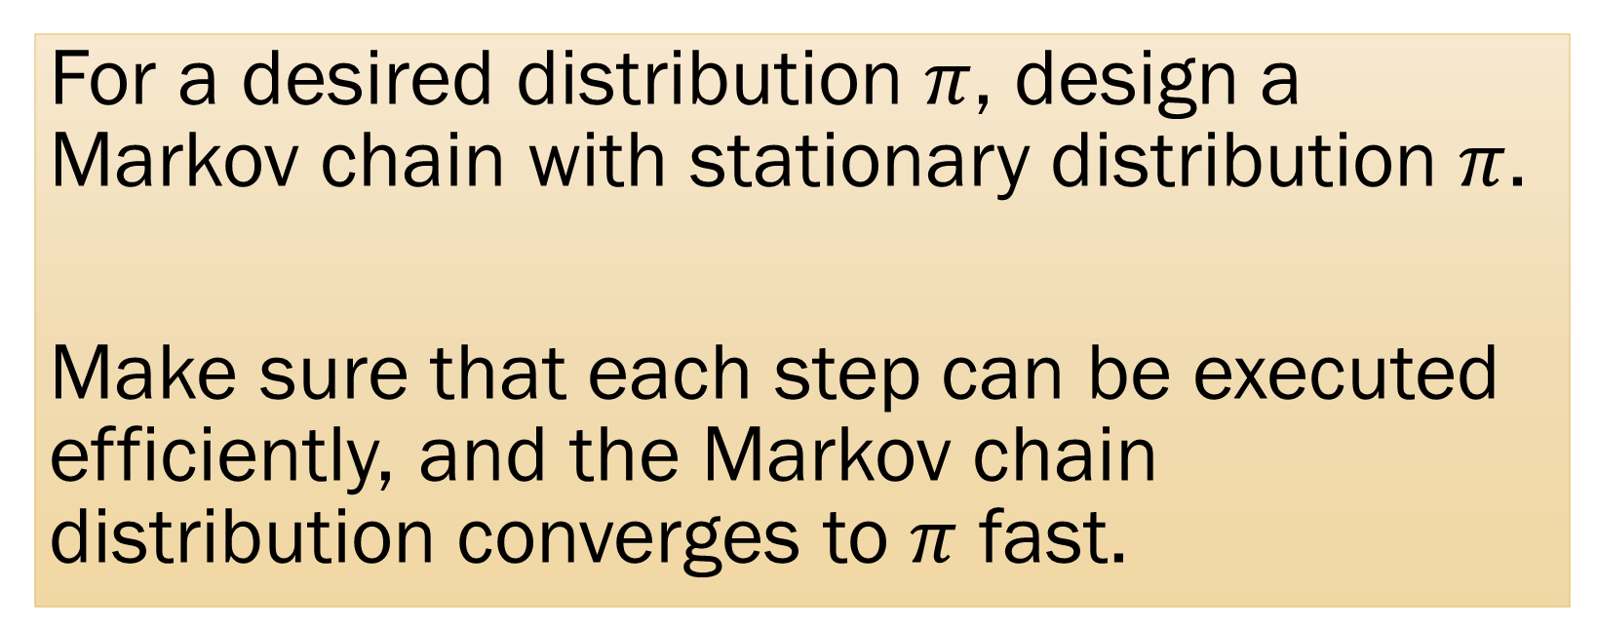
Markov Chain Monte Carlo
For a desired distribution $π$, design a Markov chain with stationary distribution $π$.
Make sure that each step can be executed efficiently, and the Markov chain distribution converges to $π$ fast.

Slide 43
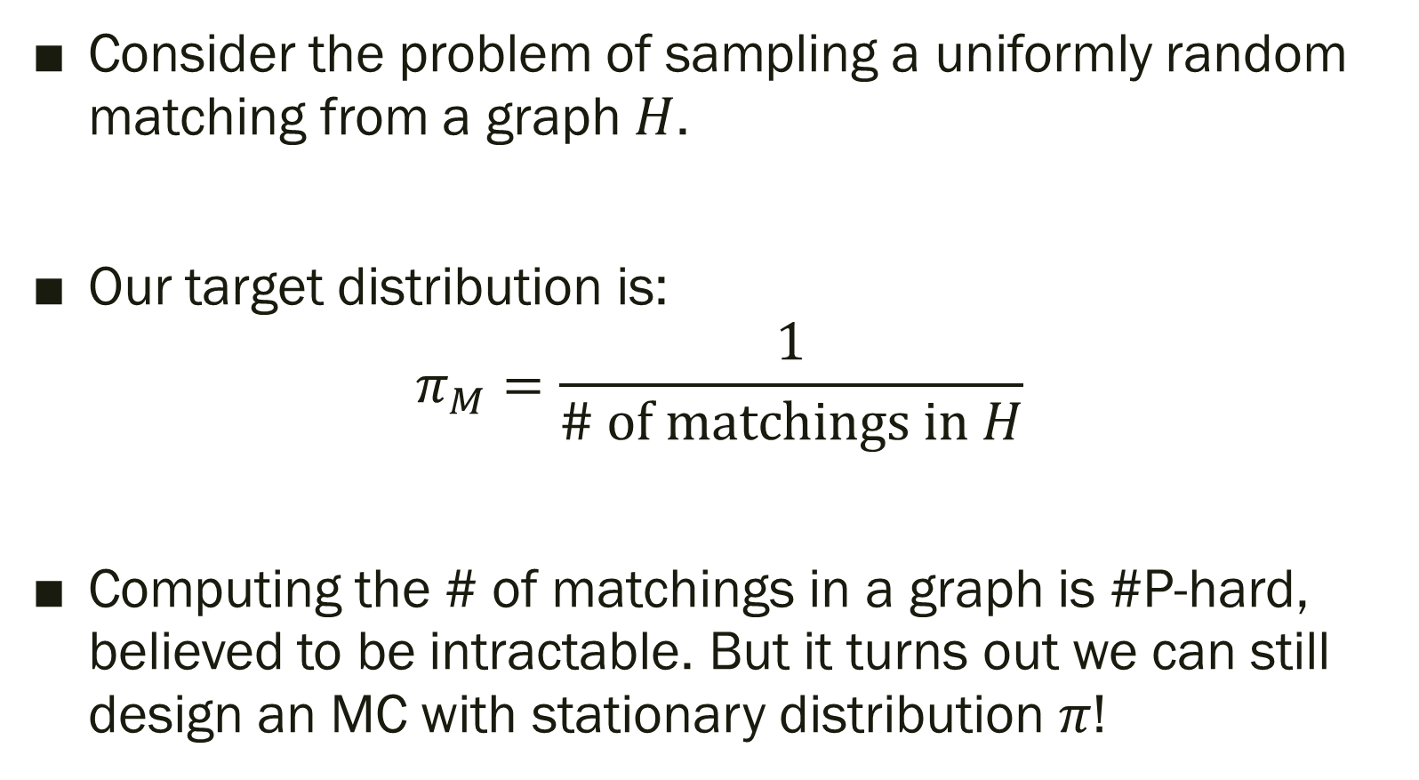
Example: Random Matching
Consider the problem of sampling a uniformly random matching from a graph $H$.
Our target distribution is:
$$π_{M}=\frac{1}{\# \text{of} \text{matchings} \text{in} H}$$
Computing the # of matchings in a graph is #P-hard, believed to be intractable. But it turns out we can still design an MC with stationary distribution $π$!

Slide 44
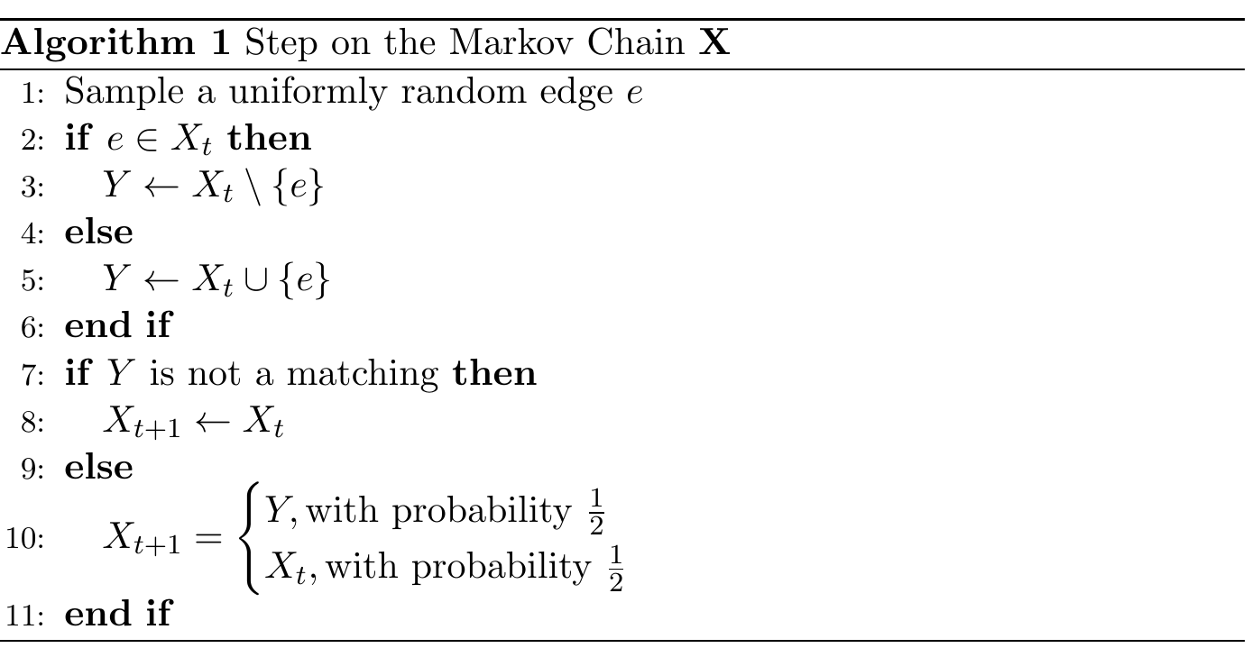
MC for generating matchings

Slide 45
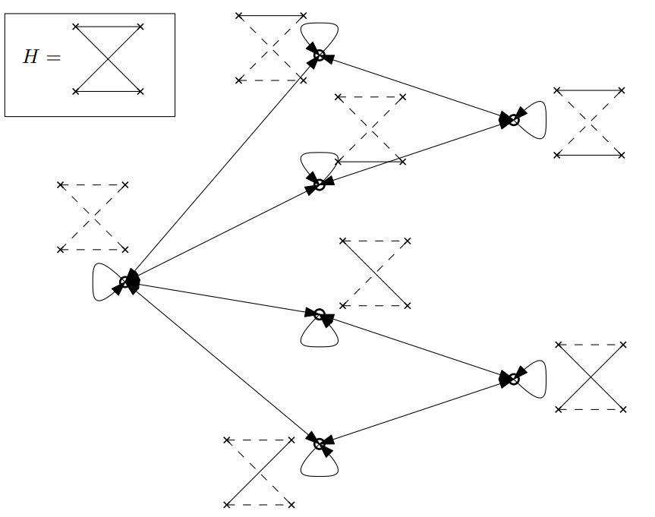
Transitions

Slide 46
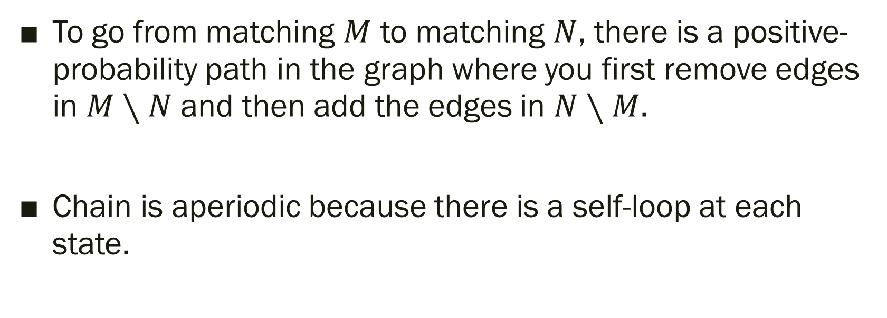
Irreducibility and Aperiodicity
To go from matching $M$ to matching $N$, there is a positive-probability path in the graph where you first remove edges in $M∖N$ and then add the edges in $N∖M$.
Chain is aperiodic because there is a self-loop at each state.

Slide 47
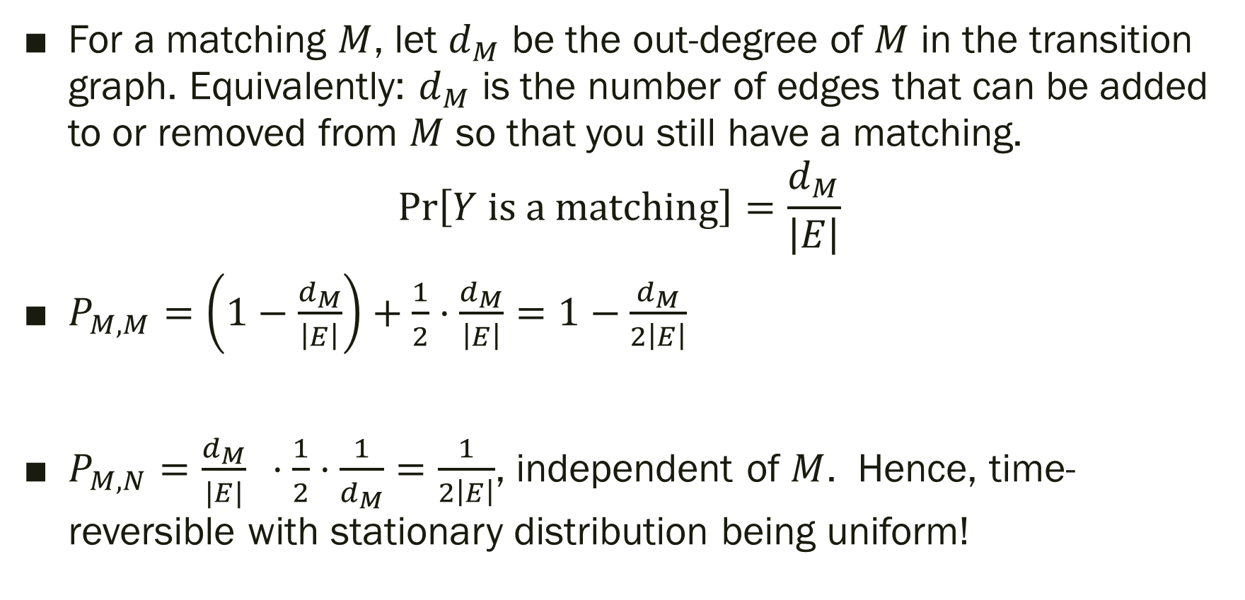
Transition Probabilities
For a matching $M$, let $d_{M}$ be the out-degree of $M$ in the transition graph. Equivalently: $d_{M}$ is the number of edges that can be added to or removed from $M$ so that you still have a matching.
$$\operatorname{Pr}\left[Y \text{is} \text{a} \text{matching}\right]=\frac{d_{M}}{\left|E\right|}$$
$P_{M,M}=\left(1−\frac{d_{M}}{\left|E\right|}\right)+\frac{1}{2}⋅\frac{d_{M}}{\left|E\right|}=1−\frac{d_{M}}{2\left|E\right|}$
$P_{M,N}=\frac{d_{M}}{|E|} ⋅\frac{1}{2}⋅\frac{1}{d_{M}}=\frac{1}{2\left|E\right|}$, independent of $M$. Hence, time-reversible with stationary distribution being uniform!

Slide 48
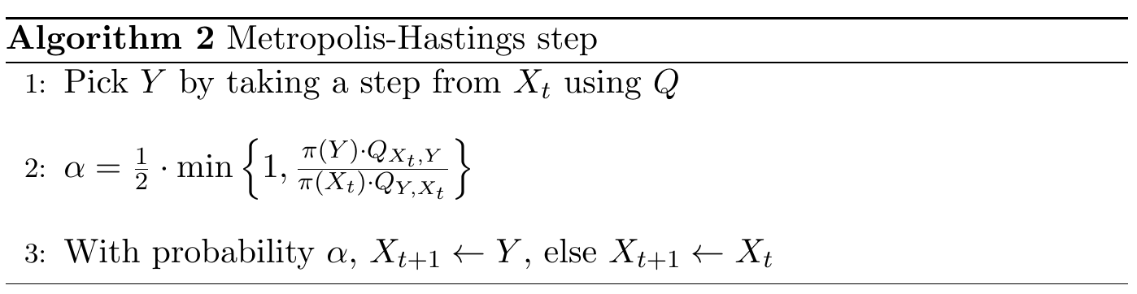
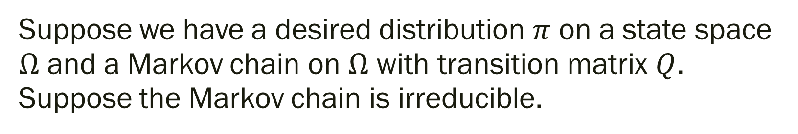
Metropolis-Hastings
Suppose we have a desired distribution $π$ on a state space $Ω$ and a Markov chain on $Ω$ with transition matrix $Q$. Suppose the Markov chain is irreducible.

Slide 49
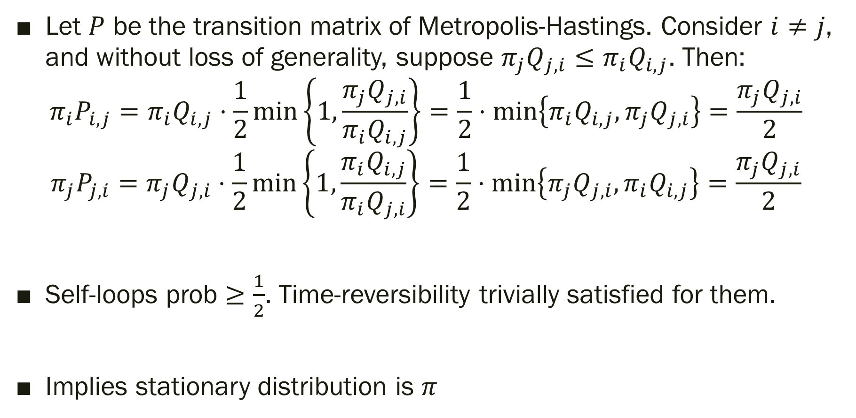
Time-Reversibility
Let $P$ be the transition matrix of Metropolis-Hastings. Consider $i≠j$, and without loss of generality, suppose $π_{j}Q_{j,i}≤π_{i}Q_{i,j}$. Then:
$$π_{i}P_{i,j}=π_{i}Q_{i,j}⋅\frac{1}{2}\min\left\{1,\frac{π_{j}Q_{j,i}}{π_{i}Q_{i,j}}\right\}=\frac{1}{2}⋅\min\left\{{π_{i}Q}_{i,j},π_{j}Q_{j,i}\right\}=\frac{π_{j}Q_{j,i}}{2}$$
$$π_{j}P_{j,i}=π_{j}Q_{j,i}⋅\frac{1}{2}min\left\{1,\frac{π_{i}Q_{i,j}}{π_{i}Q_{j,i}}\right\}=\frac{1}{2}⋅\min\left\{π_{j}Q_{j,i},π_{i}Q_{i,j}\right\}=\frac{π_{j}Q_{j,i}}{2}$$
Self-loops prob $≥\frac{1}{2}$. Time-reversibility trivially satisfied for them.
Implies stationary distribution is $π$

Slide 50
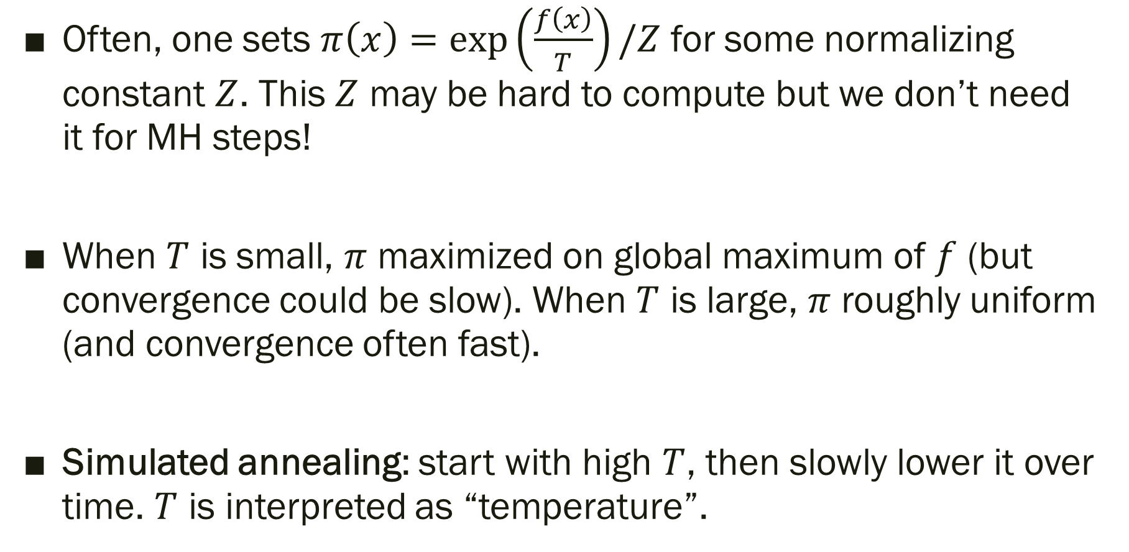
Some notes
Often, one sets $π\left(x\right)=\exp\left(\frac{f\left(x\right)}{T}\right)/Z$ for some normalizing constant $Z$. This $Z$ may be hard to compute but we don’t need it for MH steps!
When $T$ is small, $π$ maximized on global maximum of $f$ (but convergence could be slow). When $T$ is large, $π$ roughly uniform (and convergence often fast).
Simulated annealing: start with high $T$, then slowly lower it over time. $T$ is interpreted as “temperature”.

Slide 51
Takeaways
Markov chains are a powerful method to generate a target distribution.
The stationary distribution often can be computed by solving eigenvalues or verifying time-reversibility. It directly gives the mean recurrence time for states.
So far, we haven’t seen techniques for estimating how fast the distribution converges to stationary. This, we’ll do next lecture.

